Slide 1
Lending Club Case Study
Submitted by:
Deepali Jagtap
Sushen Gawhad

Slide 2
Introduction
Lending club is the largest online loan marketplace, facilitating personal loans, business loans, and financing of medical procedures. Borrowers can easily access lower interest rate loans through a fast online interface.

Slide 3
Business Understanding
When a person applies for a loan, there are two types of decisions that could be taken by the company:
Loan accepted: If the company approves the loan, there are 3 possible scenarios described below:
Fully paid
Current
Charged-off
Loan rejected: The company had rejected the loan

Slide 4
Objectives
Understanding dataset
Importing to pandas
Data cleaning
Data analysis

Slide 5
Understanding Dataset
The loan dataset is provided by lending club
It has 111 columns with different variables
It has data from details from 2007 to 2011

Slide 6
Data Cleaning
The cleaning started from removing columns with 100% null values.
The next step is to remove customer behavioral variables.
The loan status have ‘Current’ as status, which is not useful in analysis, hence removed.
New derived columns were add for additional review and analysis.

Slide 7
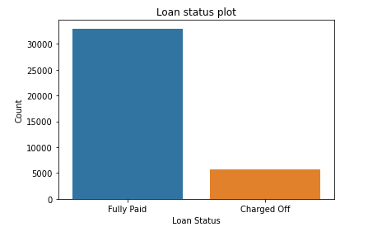
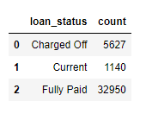
Data Analysis
Loan Status
The above count shows that 85% loans are fully paid, only 15% customers are defaulters

Slide 8
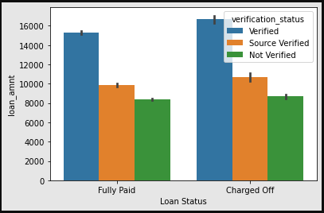
2. Verification status

Slide 9
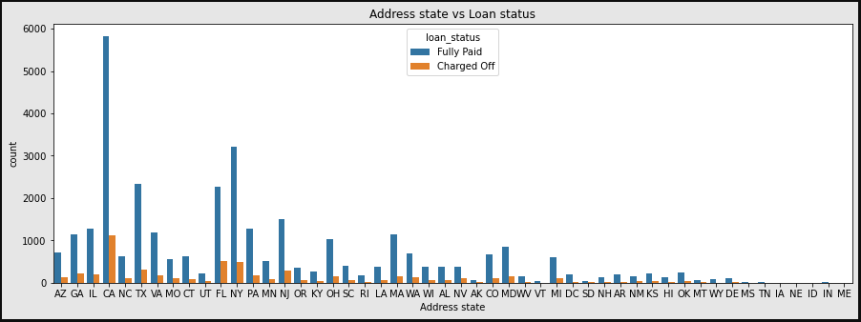
3. Address state

Slide 10
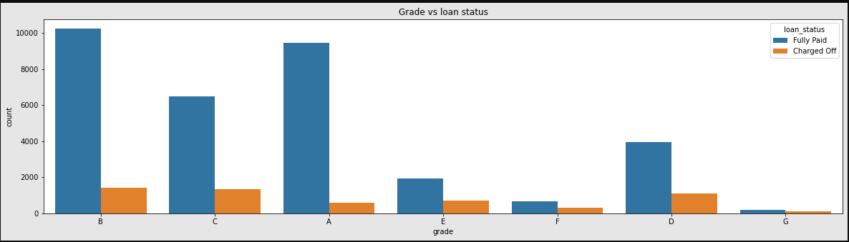
4. Grade

Slide 11
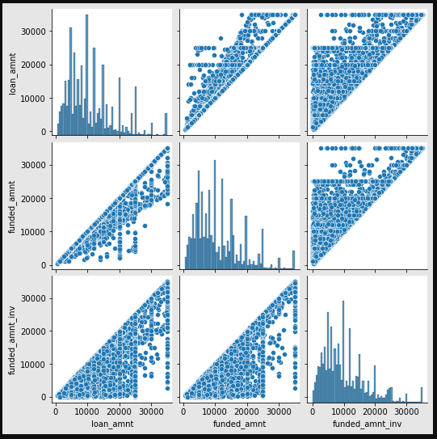
5. Loan amount, Funded Amount and fund invested

Slide 12
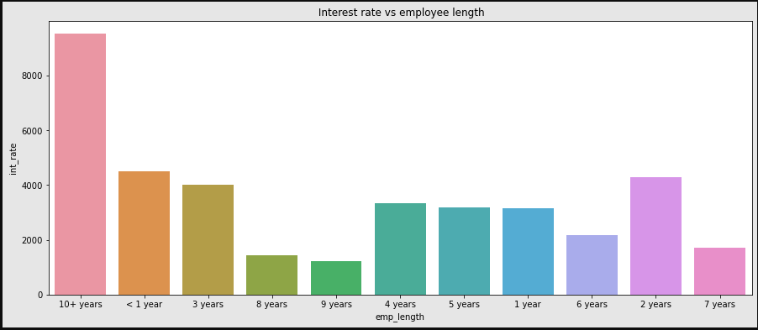
6.Interest Rate vs employee length
Interest rate is more for older peoples

Slide 13
Thank You

